Slide 1
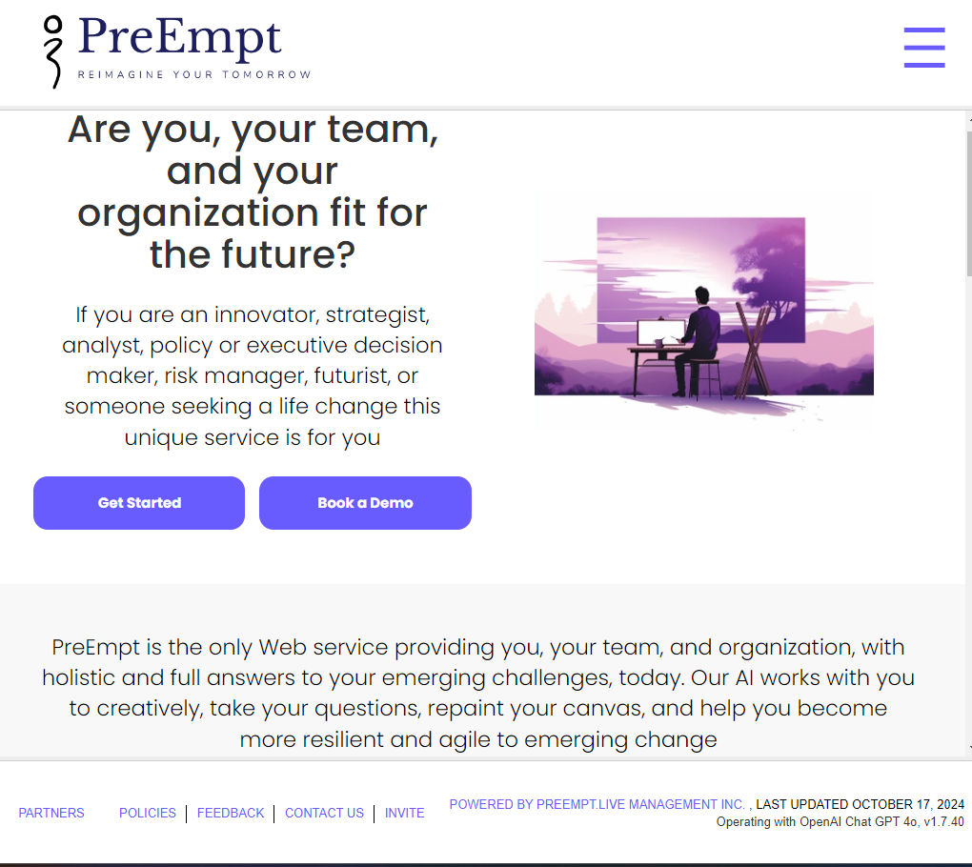

Slide 2
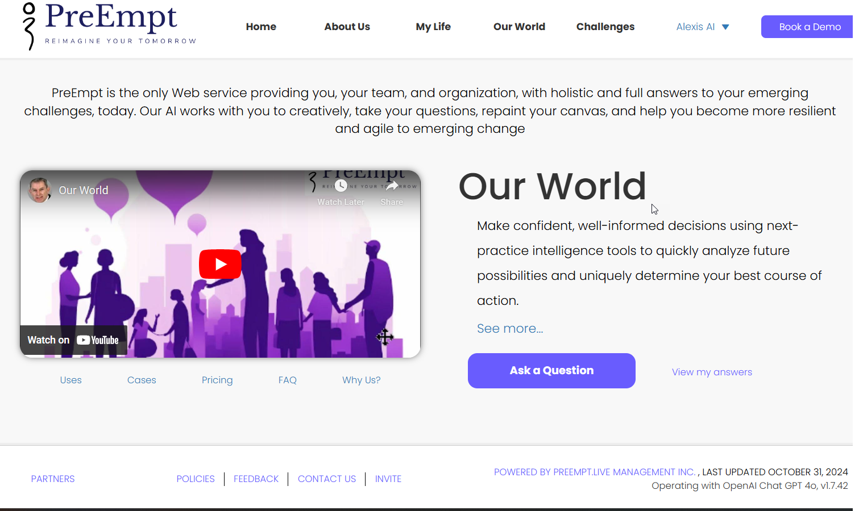
Introduction
Welcome to PreEmpt
Advanced Forward Decision Intelligence (DI) Platform
Our mission:
"Reimagine Tomorrow"

Slide 3
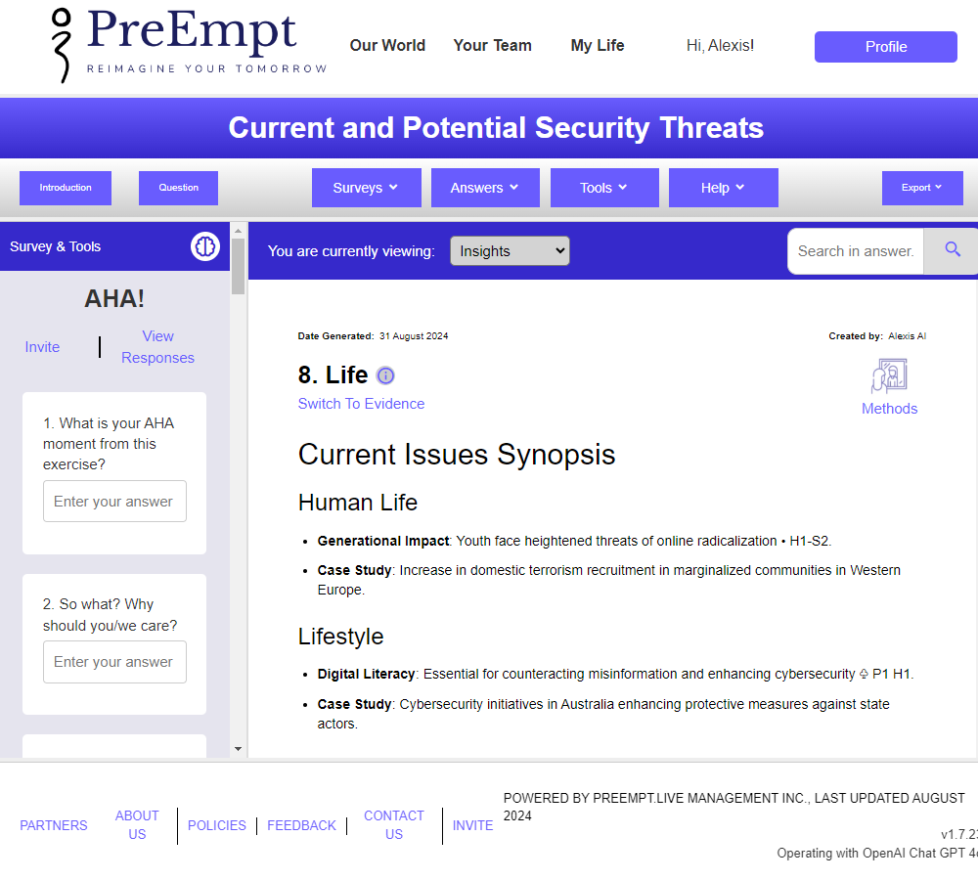
Our Purpose
Addresses emerging challenges
Democratize collective futures thinking
Unite global consciousness and digital foresight literacy
Engage stakeholders in collaborative problem solving
Offer low-cost, near-real-time foresight to all

Slide 4

EMERGING CHALLENGES
Horizon Scanning: Identifying early signals of change to stay ahead of trends.
Risk Management: Systematically assessing and responding to potential threats.
Innovation Development: Collaboratively imagining and creating new futures.
Change Management: Establishing fresh visions and processes to engage stakeholders effectively.
Strategic Foresight: Developing alternative scenarios for informed decision-making in uncertain environments
PreEmpt.life addresses various emerging challenges

Slide 5
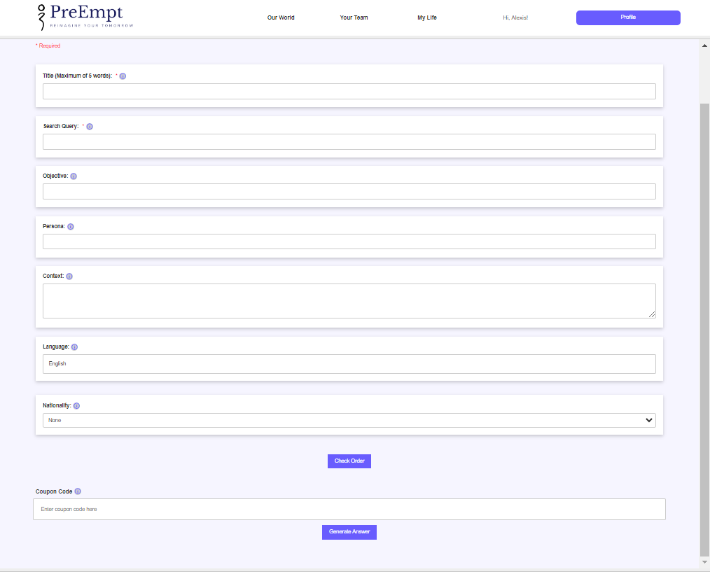
The Challenge
Global challenges require robust analytical tools
Risk of escalating uncertainty and complexity
Need for better questioning critical thinking and imagination
Ask our AI a powerful but simple question to start

Slide 6
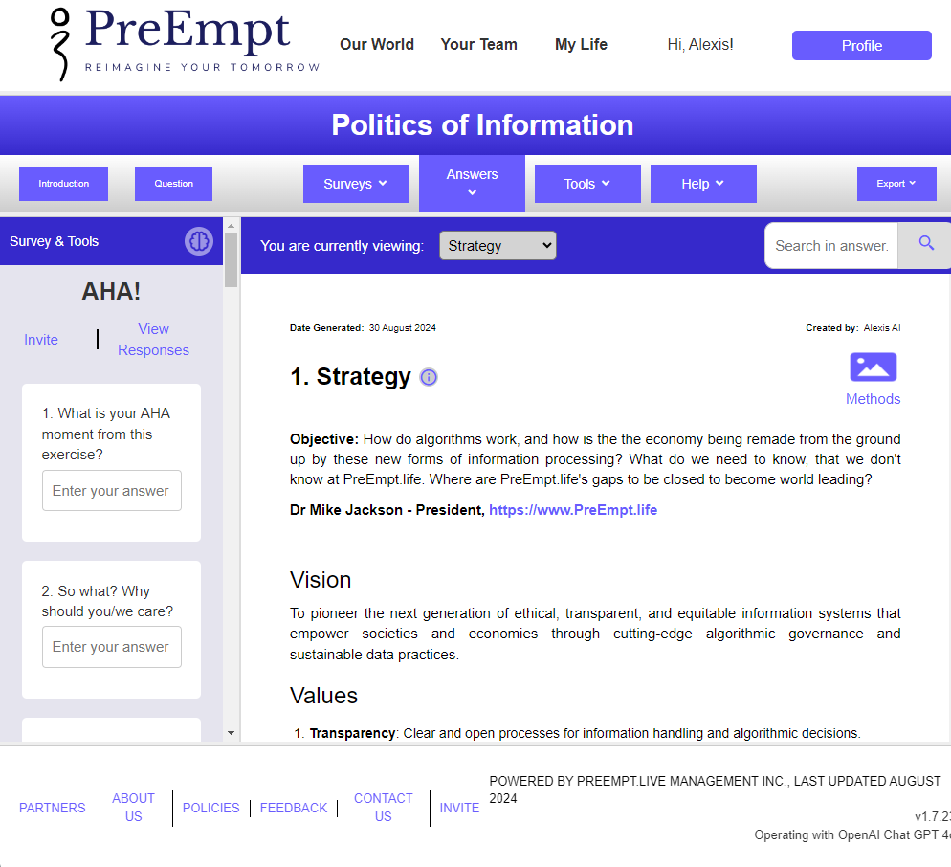
Our holistic and interdisciplinary Decision Intelligence (DI) platform integrates strategic foresight, systems, design, and critical thinking by using machine engineering practices for quality decision-making.
Non-linear, holistic, imaginative approach
Rapidly generate strategies, future possibilities, and actionable answers
Customized slides, video scripts, and reports in minutes to fit your exasct needs
Agentic assistance from Perplexity and Merlin
OUR SOLUTION

Slide 7
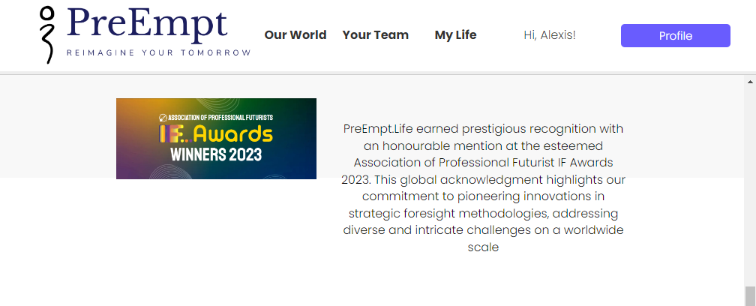
Value Proposition
Enhanced decision making
Enhanced human capabilities
Agility in strategic adaptation
Early identification of opportunities
Strengthened market positioning
Better performance
Proactive risk management
Increased innovation
Long-term sustainability
Improved stakeholder confidence

Slide 8
Unique Selling Points
Unlike many competitors, PreEmpt provides full-spectrum answers to emerging challenges, combining horizon scanning, risk identification, and scenario modeling in one platform
The service emphasizes collective futures thinking, engaging all stakeholders in collaborative problem-solving to democratize access to foresight tools
PREEMPT (HOLISTIC)
LINEAR (OTHERS)
Pattern-based
High decision HI/AI intelligence*
In-context
Holistic answers/outcomes
Answers in hours at ultra low cost
  Forecast-based
  Limited understanding and wisdom
  Out-of-context
  More questions/outputs
  Answers in months at high cost!

Slide 9

Who IS it for?
Change agents, Innovators, Strategists
Risk Managers, Problem solvers,
Designers, Critical Thinkers, Venturers
Foresighters, Researchers, Imagineers
Intelligence Analysts, Policy makers
Decision makers seeking to reimagine their organizations and their lives

Slide 10
The Preempt System
700+ integrated foresight, strategy, design, system, and critical thinking methods
Thousands of embedded, vital. and future-oriented questions
Holistic, practical, inspiring, and engaging solutions
User-friendly interface
Collaborative Toools
Cost accessibility

Slide 11

Services
Standard Outputs
Strategy
Reasoning
Insights
Evidence
Personal Futures
Private Challenges
…
To Order/coming soon
Competitive Intelligence
Scientific Discovery
Speculative Design
Possible futures
Product development
Problem solving
...

Slide 12
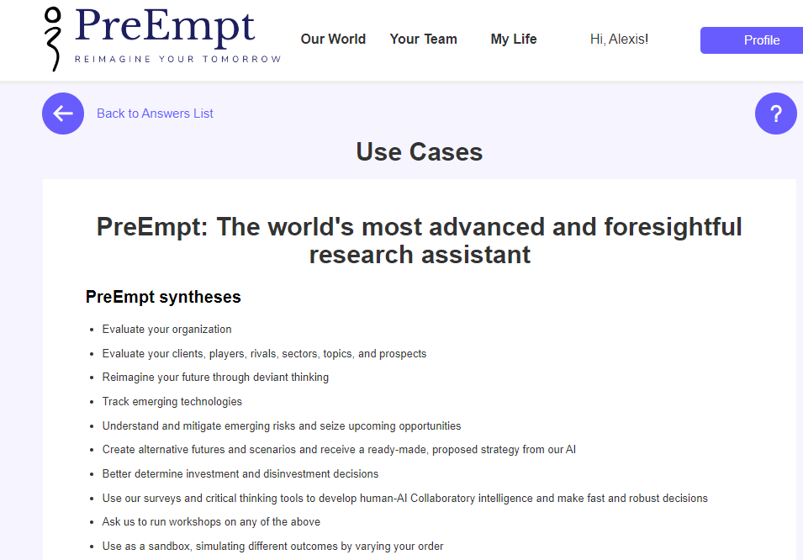
Use Cases
Evaluate organizations, sectors, and prospects
Track emerging technologies and issues
Generate alternative futures and strategies
Conduct sensitivity analysis and simulations
Set up monitoring, audit and evaluation systems

Slide 13

Human Creativity
What role does human creativity play in PreEmpt.Life's decision intelligence
Idea Generation: Creative input allows teams to brainstorm diverse solutions, moving beyond conventional approaches to problem-solving
Contextual Insight: Humans provide contextual understanding and emotional intelligence that AI lacks, enabling more nuanced interpretations of data and trends
Scenario Development: Combining human imagination with AI-generated data helps create rich, varied future scenarios, fostering strategic foresight and adaptability

Slide 14
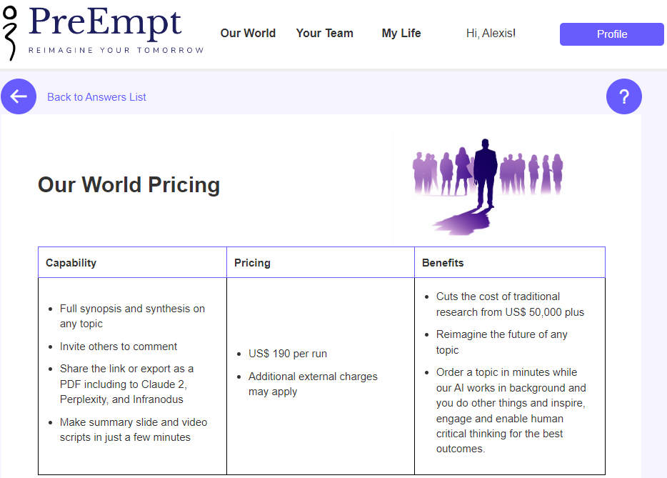
Pricing
WE ARE PIONEERS IN PRICE COMPETIVENESS AND VALUE FOR MONEY
Price per single report: $190 each
Custom private sites: $11,990 per annum
Significant cost savings compared to traditional methods
WE SEEK TO COMMODITISE DECISION INTELLIGENCE FOR THE BENEFIT OF ALL
Client sites
White labeled in your colors and logo
Fully secure
Private Challenge library
60 reports per annum
Full visualization suite (coming shortly)
Full PreEmpt support

Slide 15
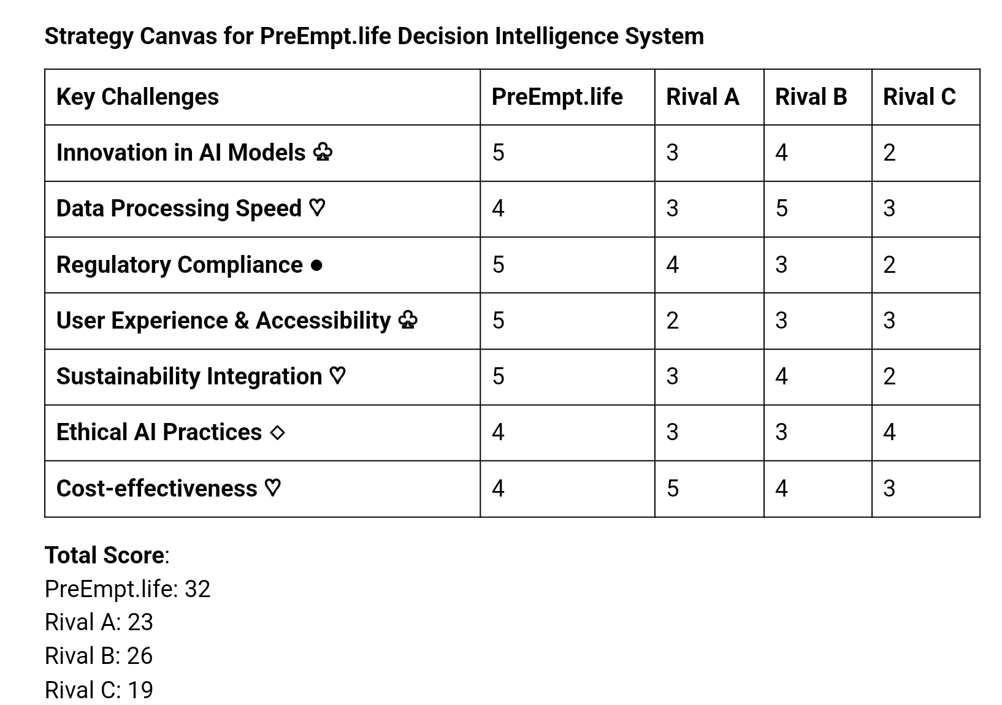
PERFORMANCE
Answers in hours instead of many team months
3,000 times faster than a human
Quality rating: consistently above standard at 8.2 to 9.2 out of 10.0
Pricing: USD 190 versus 50,000 plus using traditional, manual methods
Rival A: Google
Rival B: Microsoft
Rival C: IBM
Source: ChatGPT - October 2024

Slide 16
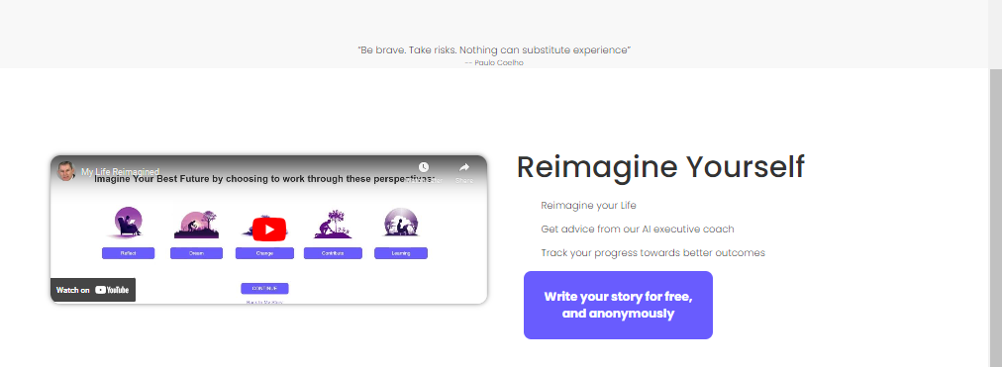
Our Beliefs
Power of prescience
Integration of AI and human ingenuity
Empowering you to cut through uncertainty
Enabling everyone to own their destinies and for free

Slide 17
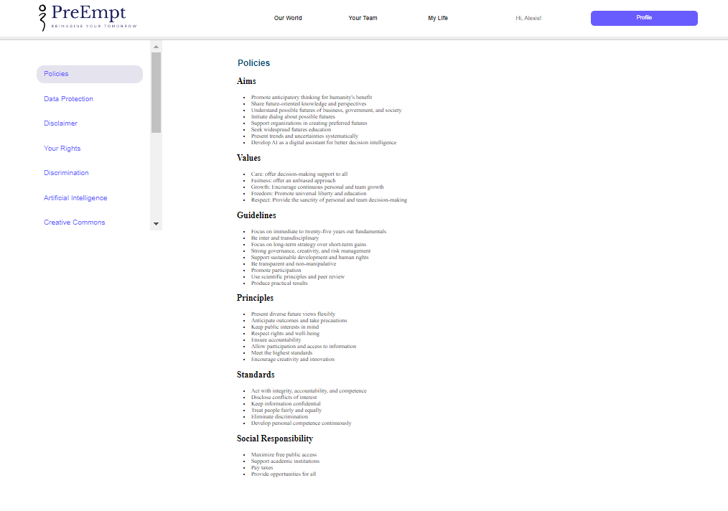

Ethics and SustainabilitY
Principles
At PreEmpt, we are determined to deliver human-centric AI solutions underpinned by:
Explainable and Self-auditing AI that turns a black box into a near white box.
Generic instructions designed to be respectful of human rights, including Safe, Sustainable, and FairAI.
Fully focusing on AI for universal human good.
Controllable AI only by humans.

Slide 18

SAFETY & SECURITY
.
Our strategies collectively contribute to a secure environment for users
Adaptive Security Integration: We utilize real-time identity-based threat prevention, which continuously assesses user behavior and access risks to preemptively address potential threats
Zero Trust Architecture: This approach ensures that all users, both inside and outside the organization, are treated as potential threats, requiring verification for access
Continuous Monitoring: The platform analyzes user actions and can trigger multi-factor authentication when suspicious behavior is detected, enhancing overall security posture

Slide 19
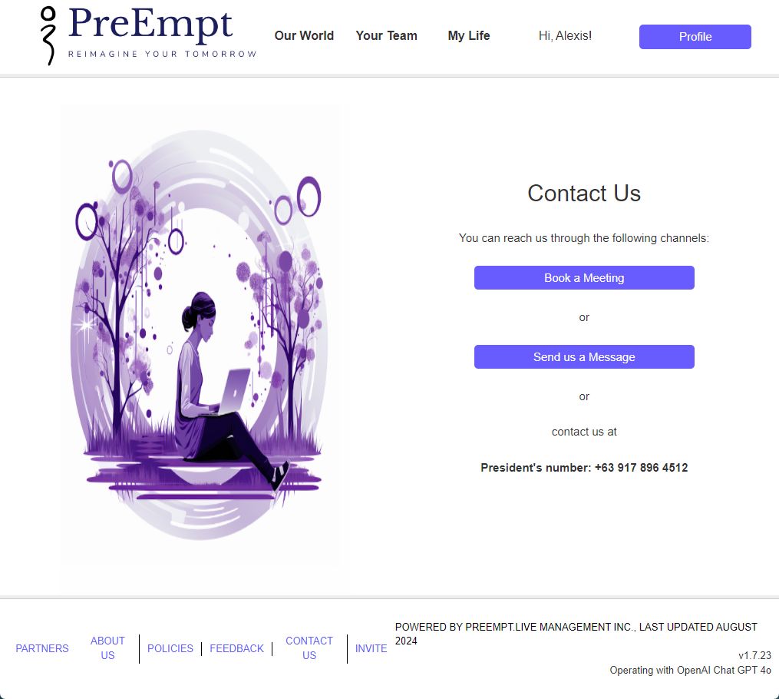
Contact US
Email: mike@preempt.life
Website: www.preempt.life
Let's reimagine your tomorrow together!

